Slide 1
Dairy Prediction using Machine Learning
Tim Pulfer, Jacob Rosen, Dhun Sheth
Notes:
Dhun

Slide 2
TABLE OF CONTENTS
01
02
03
Introduction
Initial Assessment
Improvements
Notes:
Dhun

Slide 3
Introduction to the Dataset
The motivation is to predict milk grade based on the 7 predictors outlined below. By having a reliable model to predict grade, dairy farmers can better estimate the grade of milk that will be produced before reaching the end of the milk production process.
pH
Temperature
Taste
Odor
Fat
Turbidity
Color
Grade {low, medium, high}
pH, temperature and color consist of the actual recorded values but for taste, odor, fat, and turbidity - if optimal conditions were met then the field was given a value of 1, else 0.
Grade is the predictor variable that can take on classification values of low, medium, or high.
Notes:
Tim

Slide 4
Methodology
Default Hyperparameters
Standard Scalars
Used the default hyperparameters for each model in the initial assessment.
Ensure that all features have a mean of zero and a standard deviation of one
Evaluation
Train Test Split
Determined best model based on F1 score on test set.
We adopted a 75/25 train/test split.
Notes:
Jacob

Slide 5
Initial Assessment
Model | F1 score on Test
Logistic Regression | 0.826415
Naive Bayes | 0.818868
K-Nearest Neighbours | 0.988679
Support Vector Machine | 0.932075
Decision Tree | 0.992453
Linear Discriminant Analysis | 0.701887
Random Forest | 0.992453
Notes:
Jacob

Slide 6
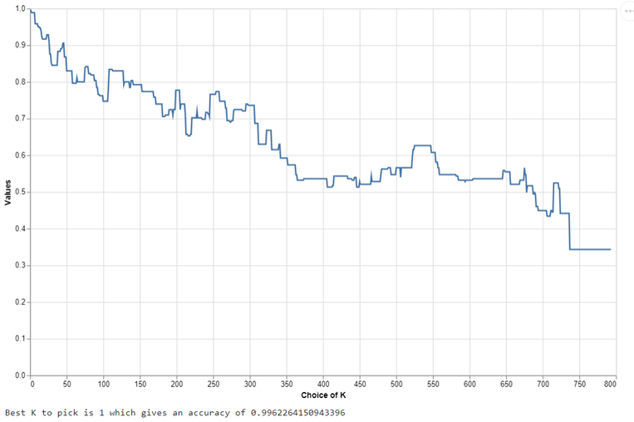
Improvements
K-Nearest Neighbors:
K = [1:794]
Default | Tuned
0.988679 | 0.996226
Notes:
Dhun

Slide 7
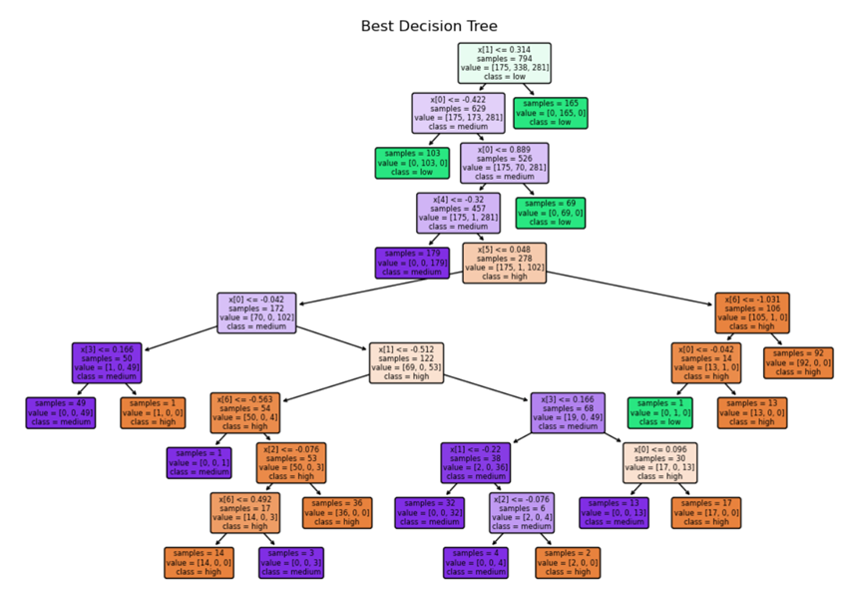
Improvements
Grid Search
Max_depth: [1,4,5,10,15,20]
Min_samples_split: [2,3,5]
Decision Trees
Default | Tuned
0.992453 | 0.992453
Notes:
Dhun

Slide 8
Future Improvements
The successful application of models such as K-Nearest Neighbors, Decision Tree, and Random Forest, all achieving high F1 scores, underscores the viability of machine learning models in this context.
However, our research also highlights a critical area for future work: the need for more nuanced data. Currently, many of the predictors in our dataset are binary (0 or 1), limiting the depth of analysis and potentially oversimplifying complex relationships between variables and milk grade outcomes. Future studies would benefit substantially from data that captures a broader spectrum of values for predictors, providing richer, more detailed insights into the factors influencing milk quality.
Notes:
Tim

Slide 9
THANK YOU
"The cow is a poem of compassion, milk a song of peace."

